Slide 1
Regelen en beveiligen in DC netten, problemen of kansen? Peter van Duijsen The Hague University of Applied Sciences
Notes:
<number>

Slide 2
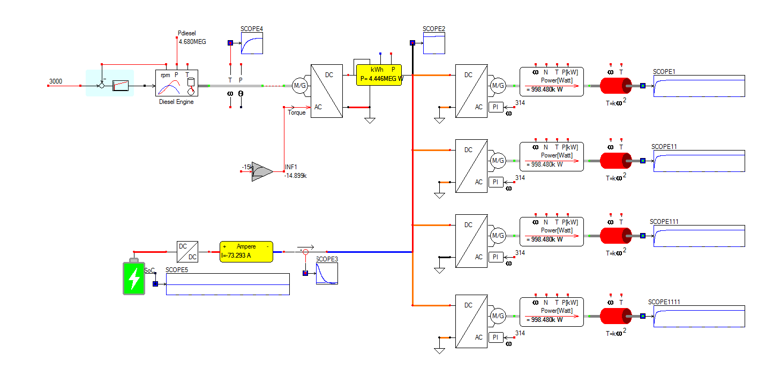
Contents
DC grid structure
Control
Switching
Protection
Stability
Notes:
<number>

Slide 3
DC grid structure?
Structure of the DC Grid
Notes:
<number>

Slide 4
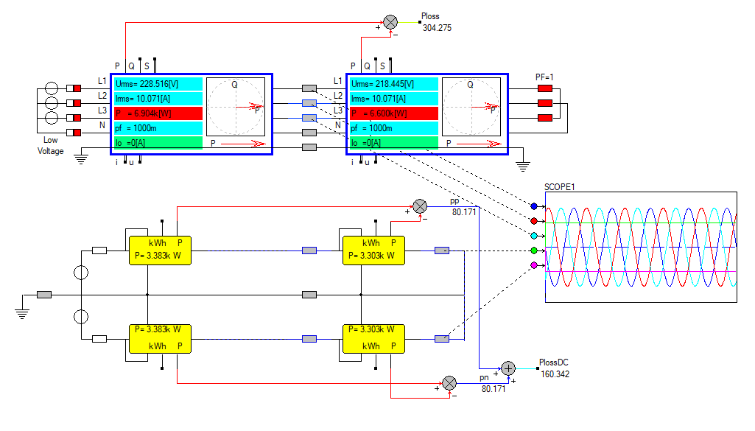
Why do we need a DC Grid? Lower losses is not the reason why we choose DC!
Notes:
<number>

Slide 5
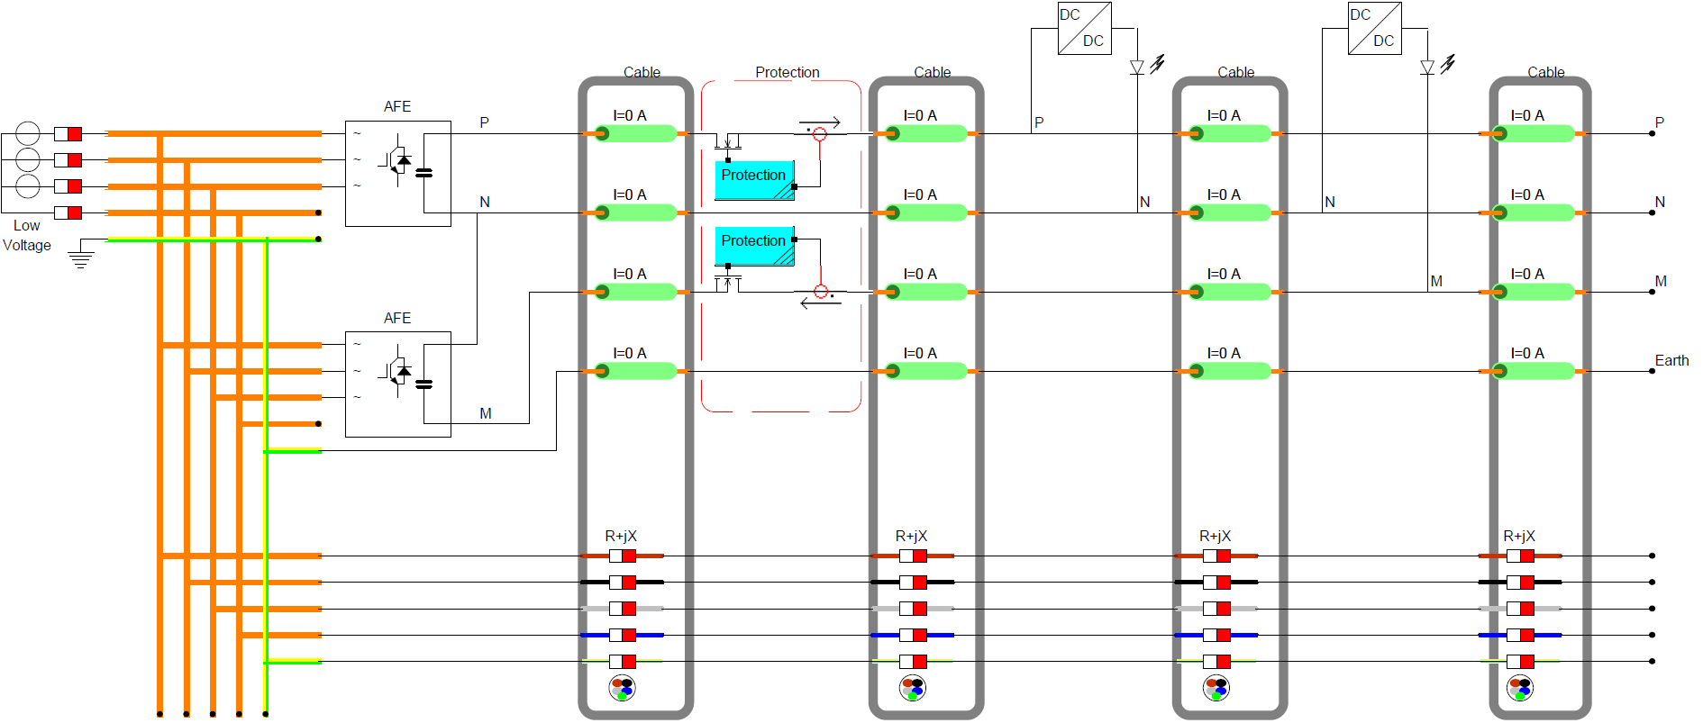
It is not about optimizing components It is optimizing the system!
Notes:
<number>

Slide 6
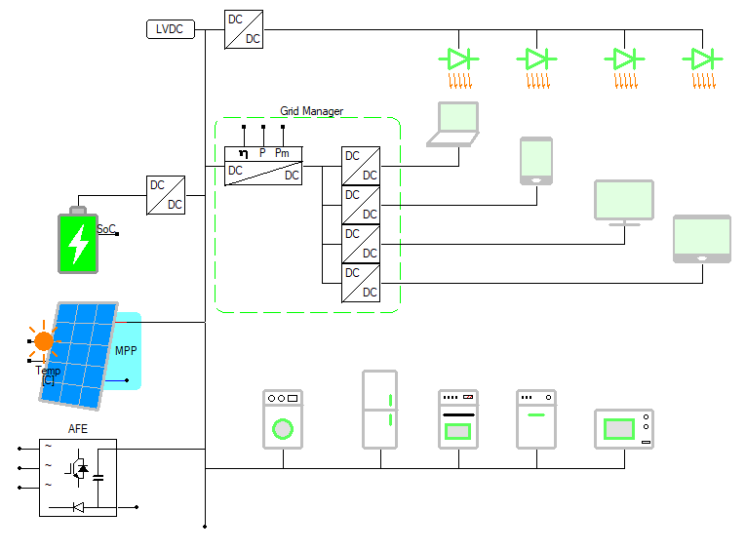
Which grid to choose?
Centralized
Decentralized
Notes:
<number>

Slide 7
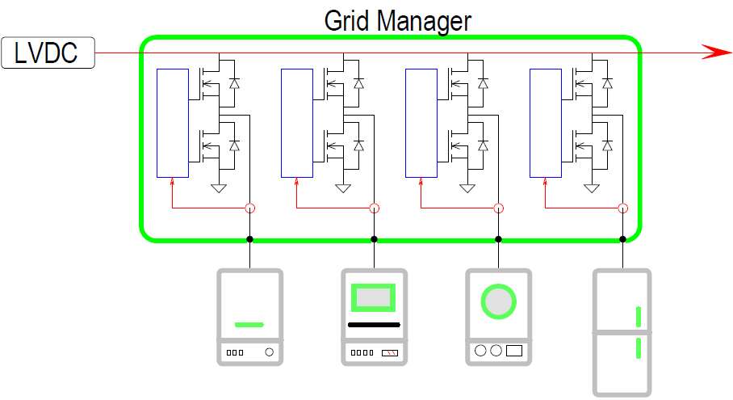
Centralized DC Grid with Grid Manager
All control in one device
Control of Power
Breaker
Inrush limiter
Notes:
<number>

Slide 8
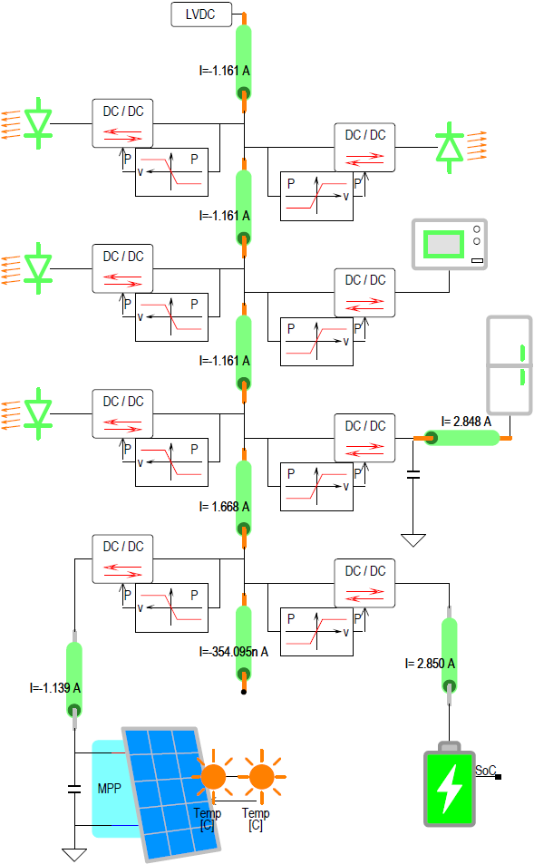
Decentralized DC Grid with Droop Control
Droop control per appliance
DCDC converter per appliance
Notes:
<number>

Slide 9
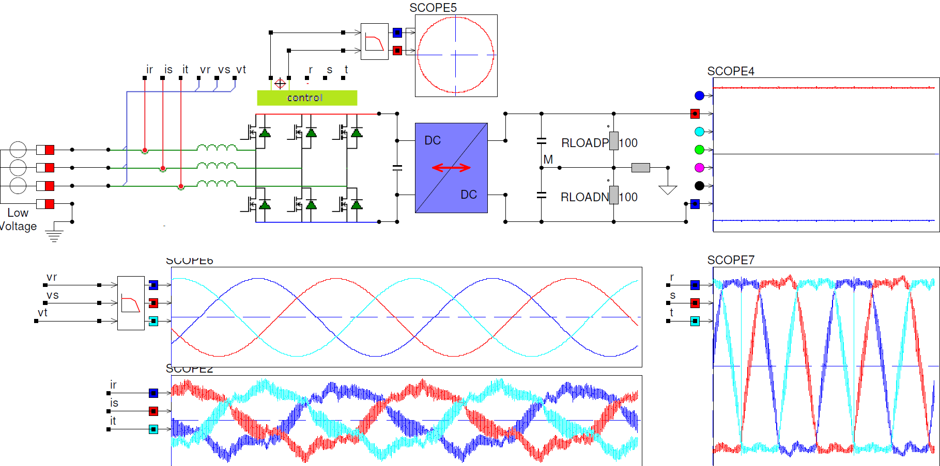
Connection to existing AC Grid?
Notes:
<number>

Slide 10
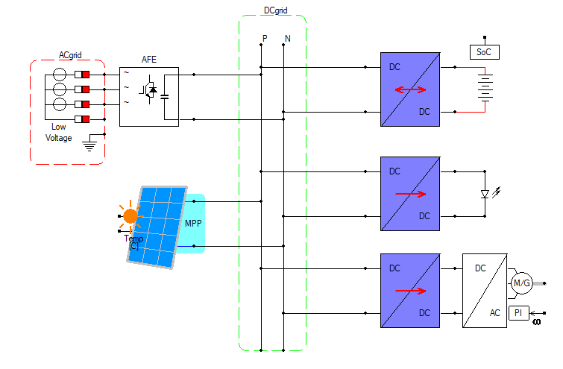
Producers and Consumers are directly coupled
Notes:
<number>

Slide 11
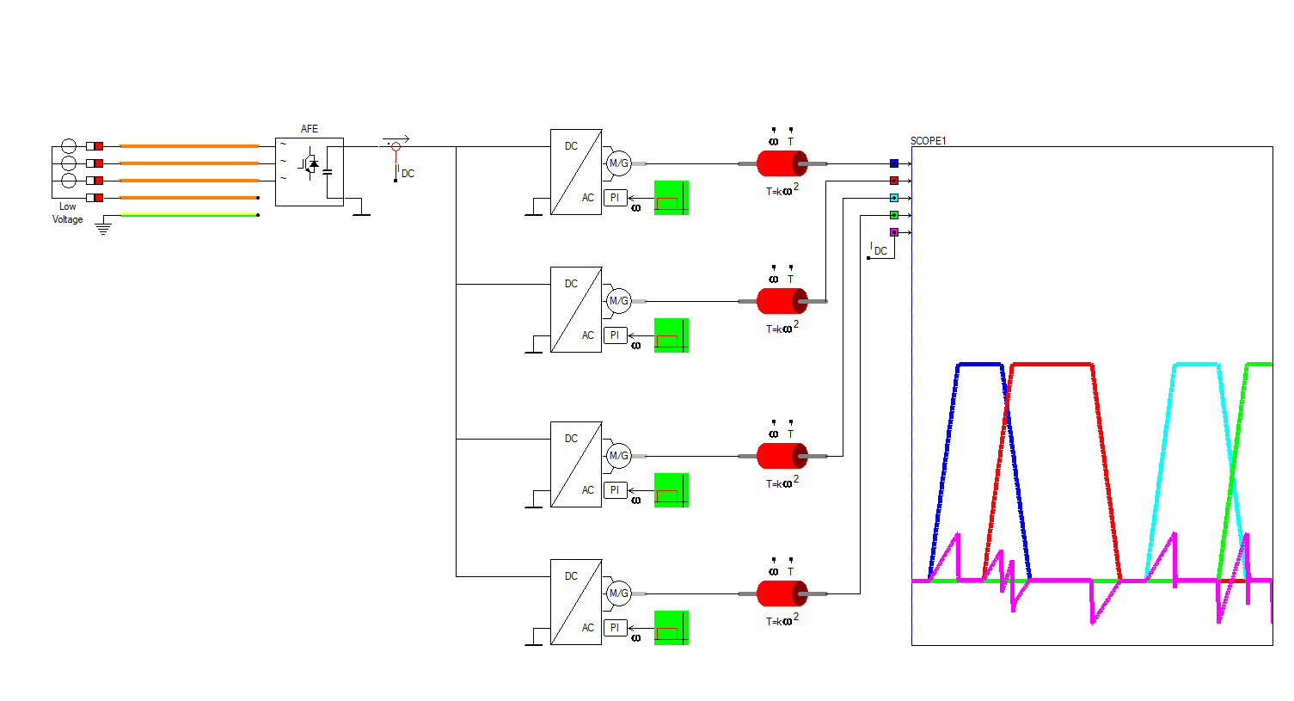
Exchange of Drive and Brake Energy
Notes:
<number>

Slide 12
Switching in the DC grid?
What type of switches do exist,
if they do exist at all?
Notes:
<number>

Slide 13
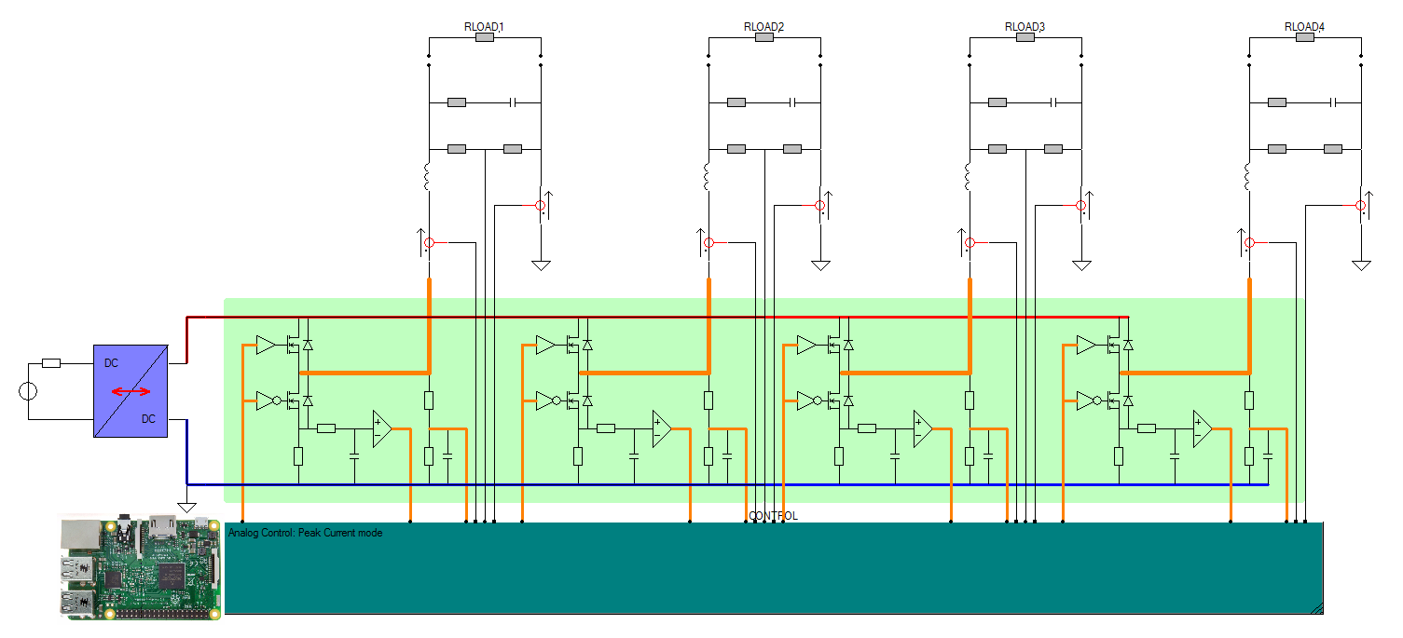
Grid Manager contains multiple Synchronous Buck Converters
power flow
Current Limited
Breaker
Non-Isolated
Notes:
<number>

Slide 14
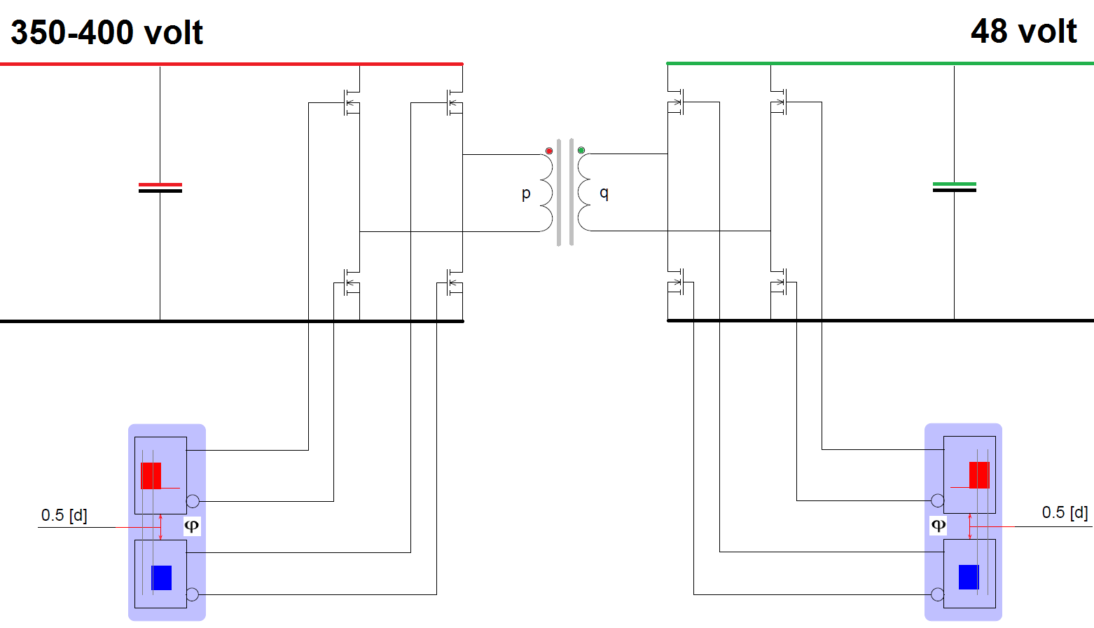
Dual Active Bridge is Isolated
Bidirectional power flow
Current Limited
Breaker
Isolated
DC transformer
Notes:
<number>

Slide 15
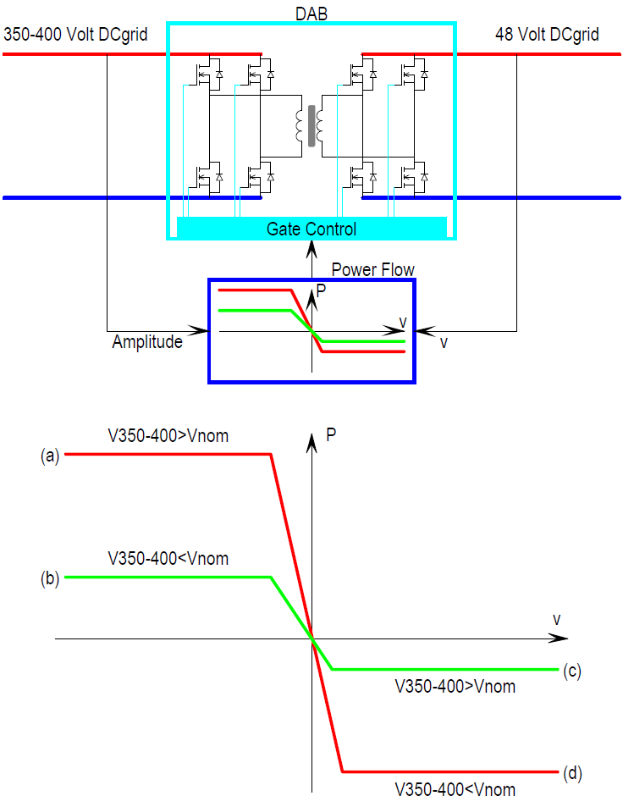
Connecting two DC grid with different voltage levels
Notes:
<number>

Slide 16
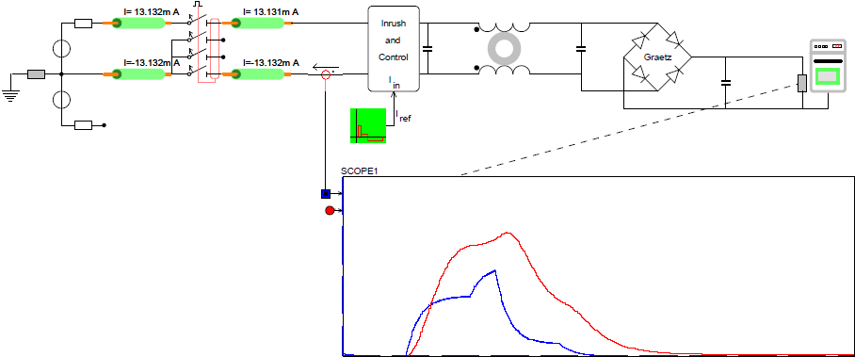
Inrush protection using a Sepic converter
Controlled current flow
Input Impedance is controlled
Notes:
<number>

Slide 17
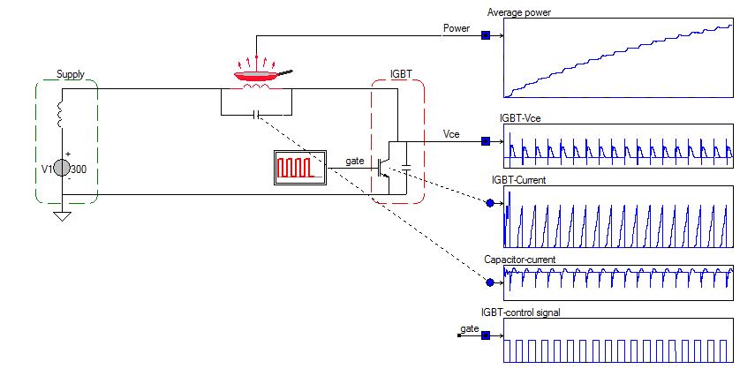
Switching Inrush protection Low side mosfet for inrush protection
Notes:
<number>

Slide 18
DC grid control?
Control and Power Congestion Management
in the DC Grid
Notes:
<number>

Slide 19
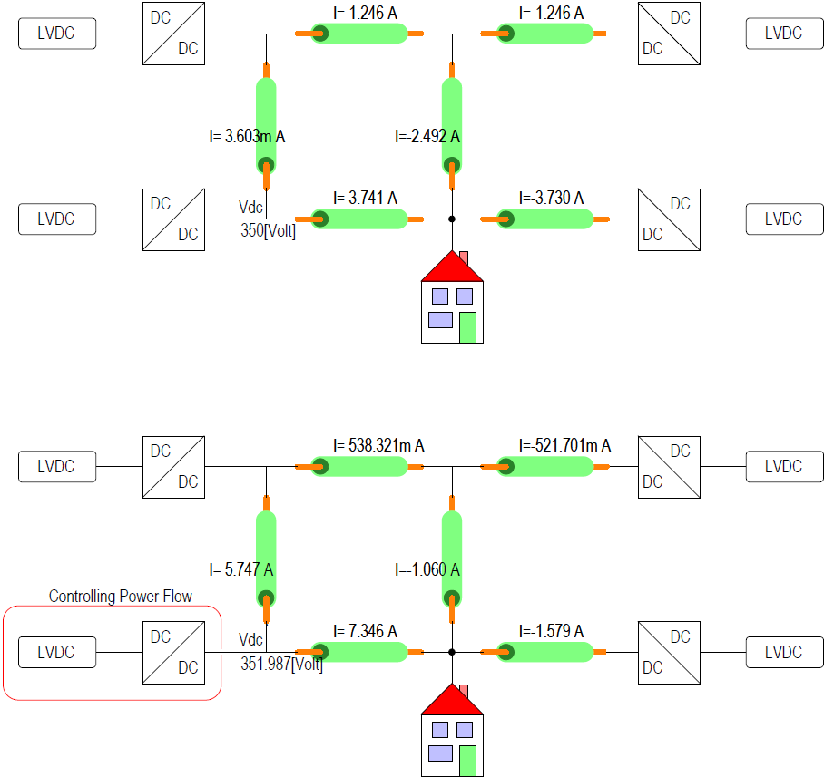
Control the current in a Meshed grid
Nodal voltage defines current flow
DCDC converters have losses
Notes:
<number>

Slide 20
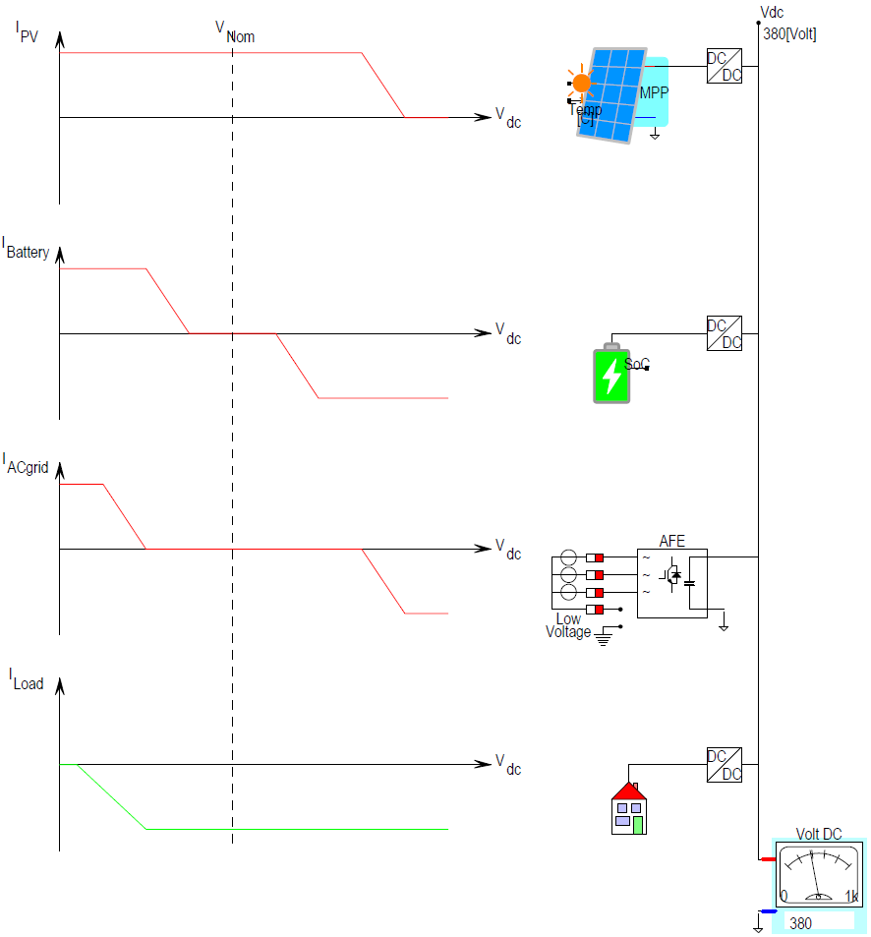
Droop Control regulates in a decentralized grid
Controlled current flow per appliance
Islanding operation
No communication required
Notes:
<number>

Slide 21
DC grid selectrivity and protection?
Protection and/or selectivity
in the DC Grid?
Notes:
<number>

Slide 22
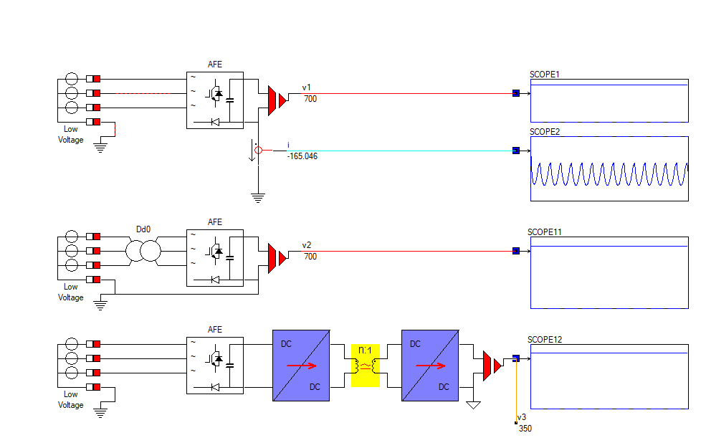
When grounding, the DC grid has to be isolated from the AC grid
Notes:
<number>

Slide 23
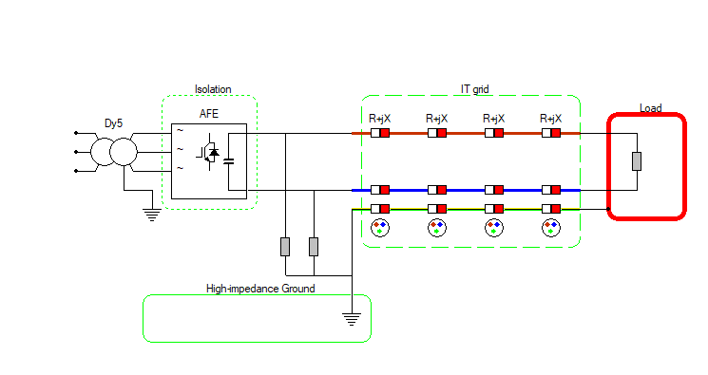
Grid system?
You can choose an isolated Grid IT to implement earth leakage detection,
but your grid is floating!
Notes:
<number>

Slide 24
Grid system?
You can choose an isolated Grid IT to implement earth leakage detection,
but your grid is floating!
Notes:
<number>

Slide 25
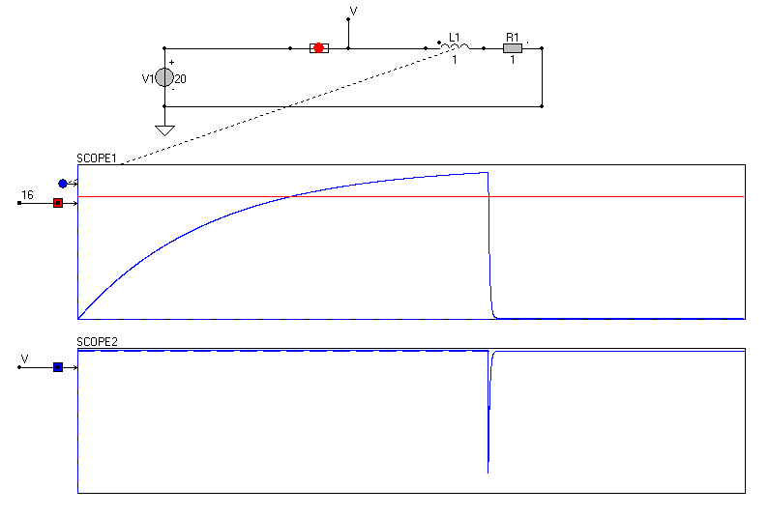
Fuse?
Notes:
<number>

Slide 26
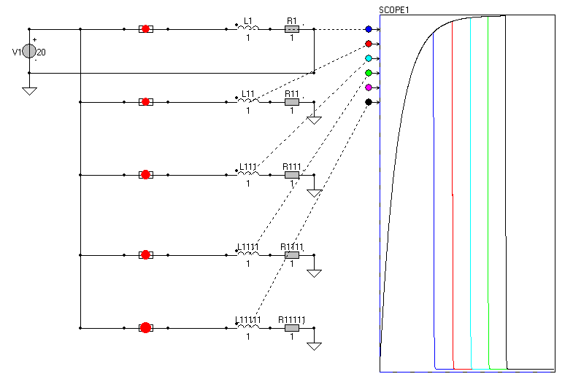
Fuse?
Notes:
<number>

Slide 27
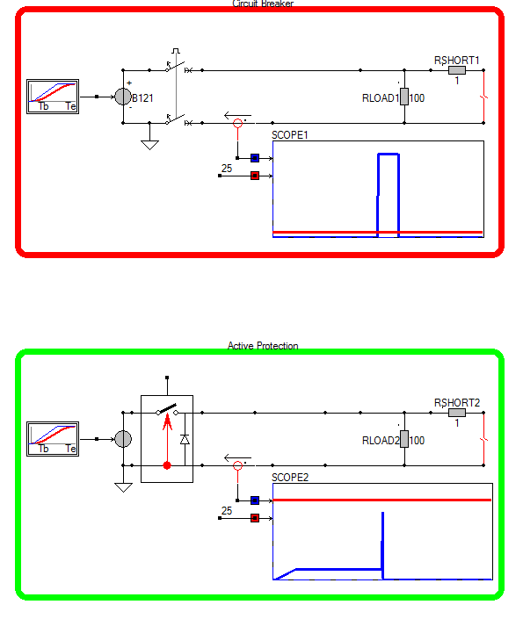
RoCoC Rate of Change of Current
Notes:
<number>

Slide 28
DC grid stability?
How to predict and ensure stability in the
DC Grid
Notes:
<number>

Slide 29
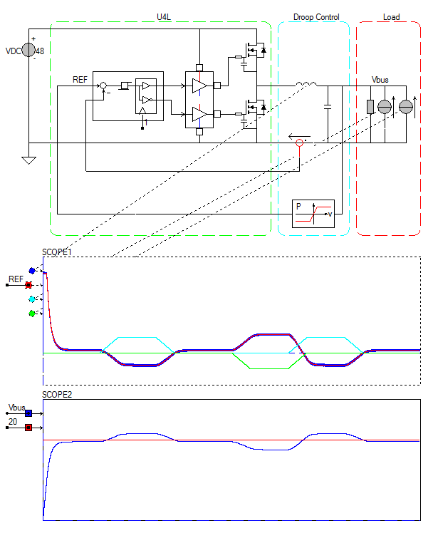
Static stability depends in Droop Control Characteristics
Droop characteristic
per appliance
Low Bandwidth
Stand alone operation
Notes:
<number>

Slide 30
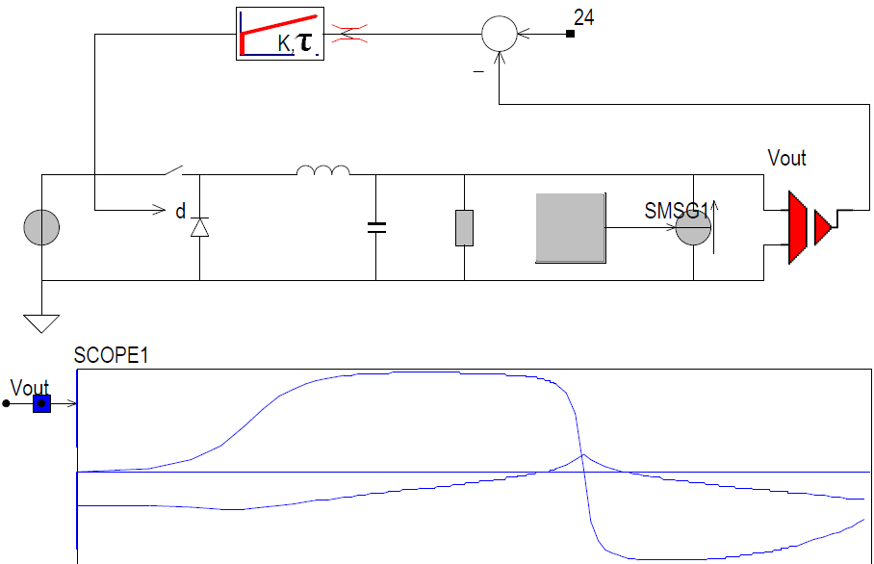
Dynamic stability depends on input and output impedance
Zout < Zin
Middlebrooks Stability Criterion
Notes:
<number>

Slide 31
DC Grid: Protect or Control?
Centralized or Decentralized
Control
Protection
Stability
Thanks for your attention!
Notes:
<number>

Slide 32
Conclusion: DC Grid: Protect or Control?
Centralized or Decentralized
Control
Protection
Stability
Thanks for your attention! www.dc-lab.org
Notes:
<number>

